Slide 1
Drugs used in thyroid disorders
Dr.Nathasha Luke

Slide 2
Treatment of thyroid disorders
Thyroid hormone physiology
Treatment of hypothyroidism
Treatment of hyperthyroidism

Slide 3
Thyroid hormone physiology
2 naturally occurring active forms
-T3 ---tri-iodo-L-thyronine
-T4 ---- tetra-iodo-L-thyronine
T4 is the precursor of T3
T3 –most active form

Slide 4
Thyroxin therapy
Treating hypothyroidism
Management of thyroid carcinoma

Slide 5
Thyroxin preparations
Levothyroxine (T4)
-Drug of choice to treat hypothyroidism
-T1/2 -7d in euthyroid
Liothyronine(T3)
-More potent than T4.
-T1/2 2 days
-Rapid onset of action-can induce heart failure-so not routinely used
T3/T4 combinations-not adequately evaluated yet

Slide 6
Treatment of hypothyroidism
Recommended Levothyroxine dosage -1.6 μg/kg per day in adults
Lower initial dose in ,
- elderly
-those with cardiac disease

Slide 7
Taken on an empty stomach upon waking in the morning
spaced out from meals, tea, coffee, by at least ½-1 hour duration.

Slide 8
Treatment of hypothyroidism-monitoring
Evaluate clinically and with FT4 6-8 weekly till FT4 and TSH are normalized.
Once the thyroid functions have normalized, patient can be reviewed every 6 to 12 months.
Avoid overtreatment -----Osteoporosis /atrial fibrillation may result

Slide 9
Causes of failure to normalize TSH during treatment
• Non compliance
• Factors affecting absorption
-Taking levothyroxine close to a meal
- Drug interfering in absorption e.g. cholestyramine, ferrous sulfate
-malabsorption
• Drugs accelerating metabolism
e.g. phenytoin, carbamazepine
• Bioequivalence of different levothyroxine preparations may differ.

Slide 10
Hypothyroidism in pregnancy
• Untreated hypothyroidism during pregnancy -increase the incidence of maternal and fetal complications including impairment of fetal cognitive development.
• Increase the dose of levothyroxine as soon as pregnancy is confirmed
Monitor TFT frequently and adjust dose
Screen neonate for hypothyroidism

Slide 11
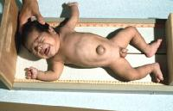
Congenital hypothyroidism in children
A cause of preventable mental retardation
Neonates routinely screened in some countries
Normalization of thyroxin levels before or by the time of 3 weeks is important for a good outcome

Slide 12
Congenital hypothyroidism in children
Starting dose -10-15 μg /kg /d
Monitor TFT frequently
- 2-4 weekly after initial treatment, until free T4 normalizes
- Every 1-2 monthly in the first 6 m
- Every 3-4 monthly-----6 m-3 y
- Every 6-12 monthly-----------3 y onwards
Aim serum FT4 in the upper normal range and within the reference range.
Monitor growth and development

Slide 13
In central hypothyroidism replace cortisol deficiency prior to starting levothyroxin

Slide 14
Thyroxin in thyroid CA management
In thyroid carcinoma patients, aim of levothyroxine therapy is to achieve appropriate TSH suppression.

Slide 15
Treatment of hypothyroid coma
Slow rise of core temperature
Warm humidified oxygen
Monitoring of vitals
High dose of levothyroxine 300-500μg via NG
Hydrocortisone IV

Slide 16
Treatment of hyperthyroidism
Symptomatic treatment –Beta blockers ----withdraw once euthytoid –propranolol
Definite treatment
-antithyroid drugs
-radioiodine
-surgery

Slide 17
Antithyroid drugs
preferred first line treatment for Grave’s disease and until definitive treatment for toxic multinodular goiter and toxic adenoma.

Slide 18
Antithyroid drugs
Carbimazole/ methimazole
Propylthiouracil

Slide 19
Antithyriod drugs –mechanism of action
inhibit thyroid hormone synthesis by interfering with thyroid peroxidase mediated iodination of tyrosine residues in thyroglobulin, an important step in the synthesis of thyroxine and triiodothyronin
Propylthiouracil can also block the conversion of T4 to T3.
antithyroid drugs may have clinically important immunosuppressive effects

Slide 20
Antirhyroid drugs
relatively simple molecules
Actively concentrated by the thyroid gland

Slide 21
Adverse effects
Minor
urticaria and other rashes
arthralgia
gastrointestinal upset
Major
Agranulocytosis
Hepatotoxicity
Vasculitis

Slide 22
Antithyroid drugs
Start treatment at high dose and titrate to a lower dose
Duration of Tx- 12-18 months
Monitoring treatment
-FT4/TSH
- Baseline FBC and liver profile.

Slide 23
 Patient education to seek medical advice urgently in the presence of side effects (pruritic rash, jaundice, pharyngitis, fever) with urgent FBC and liver functions is mandatory.

Slide 24
Antithyorid drugs in pregnancy and lactation
Both carbimazole and PTU are NOT considered 100% safe –but PTU preferred in pregnancy as carbimazole causes fetal malformations (aplasia cutis)
Both are safe in lactation

Slide 25
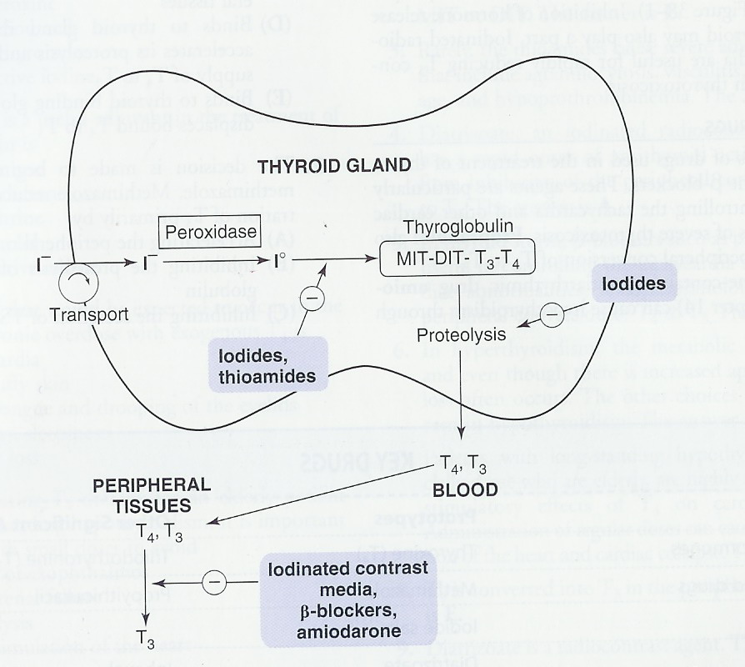

Slide 26
Iodides (NaI, KI)
Pharmacological action
Inhibition of T3 & T4 release and synthesis
Decrease of size & vascularity of the hyperplastic gland
Indications
1.Hyterthyroidism
2. Thyroid crisis.

Slide 27
Thyroid storm –management
• Thermal regulation
• Treatment of arrhythmias
• Treatment of precipitating cause eg. -. antibiotics
• Propylthiouracil (to block thyroid hormone synthesis and T4 to T3 conversion)
• Potassium iodide therapy (Lugol solution) -to inhibit thyroid hormone release
• Beta blockers
• Intravenous hydrocortisone 100mg 6 hourly (to inhibit T4 to T3 conversion)

